Slide 1
Lecture #8
Enzyme measurements
Aims:
Understand the basic principles and application-related significance of enzymes
Get introduced into enzyme screens via fluorescence-activated droplet sorting
Become familiar with your practical task

Slide 3
Report & presentation
05.12.2025: presentations Groups A & B
12.12.2025: presentations Groups C & D
15.12.2025: submit reports
16.12.2025: individual Q&A
Final report: 8 – 10 pages
- introduction
- explain your design
- construction steps
- experimental analysis

Slide 4
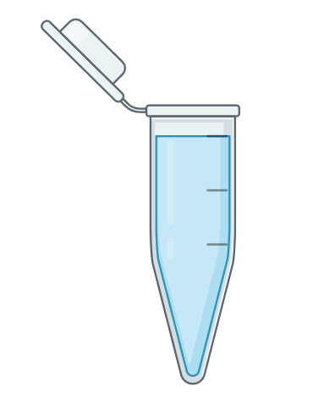
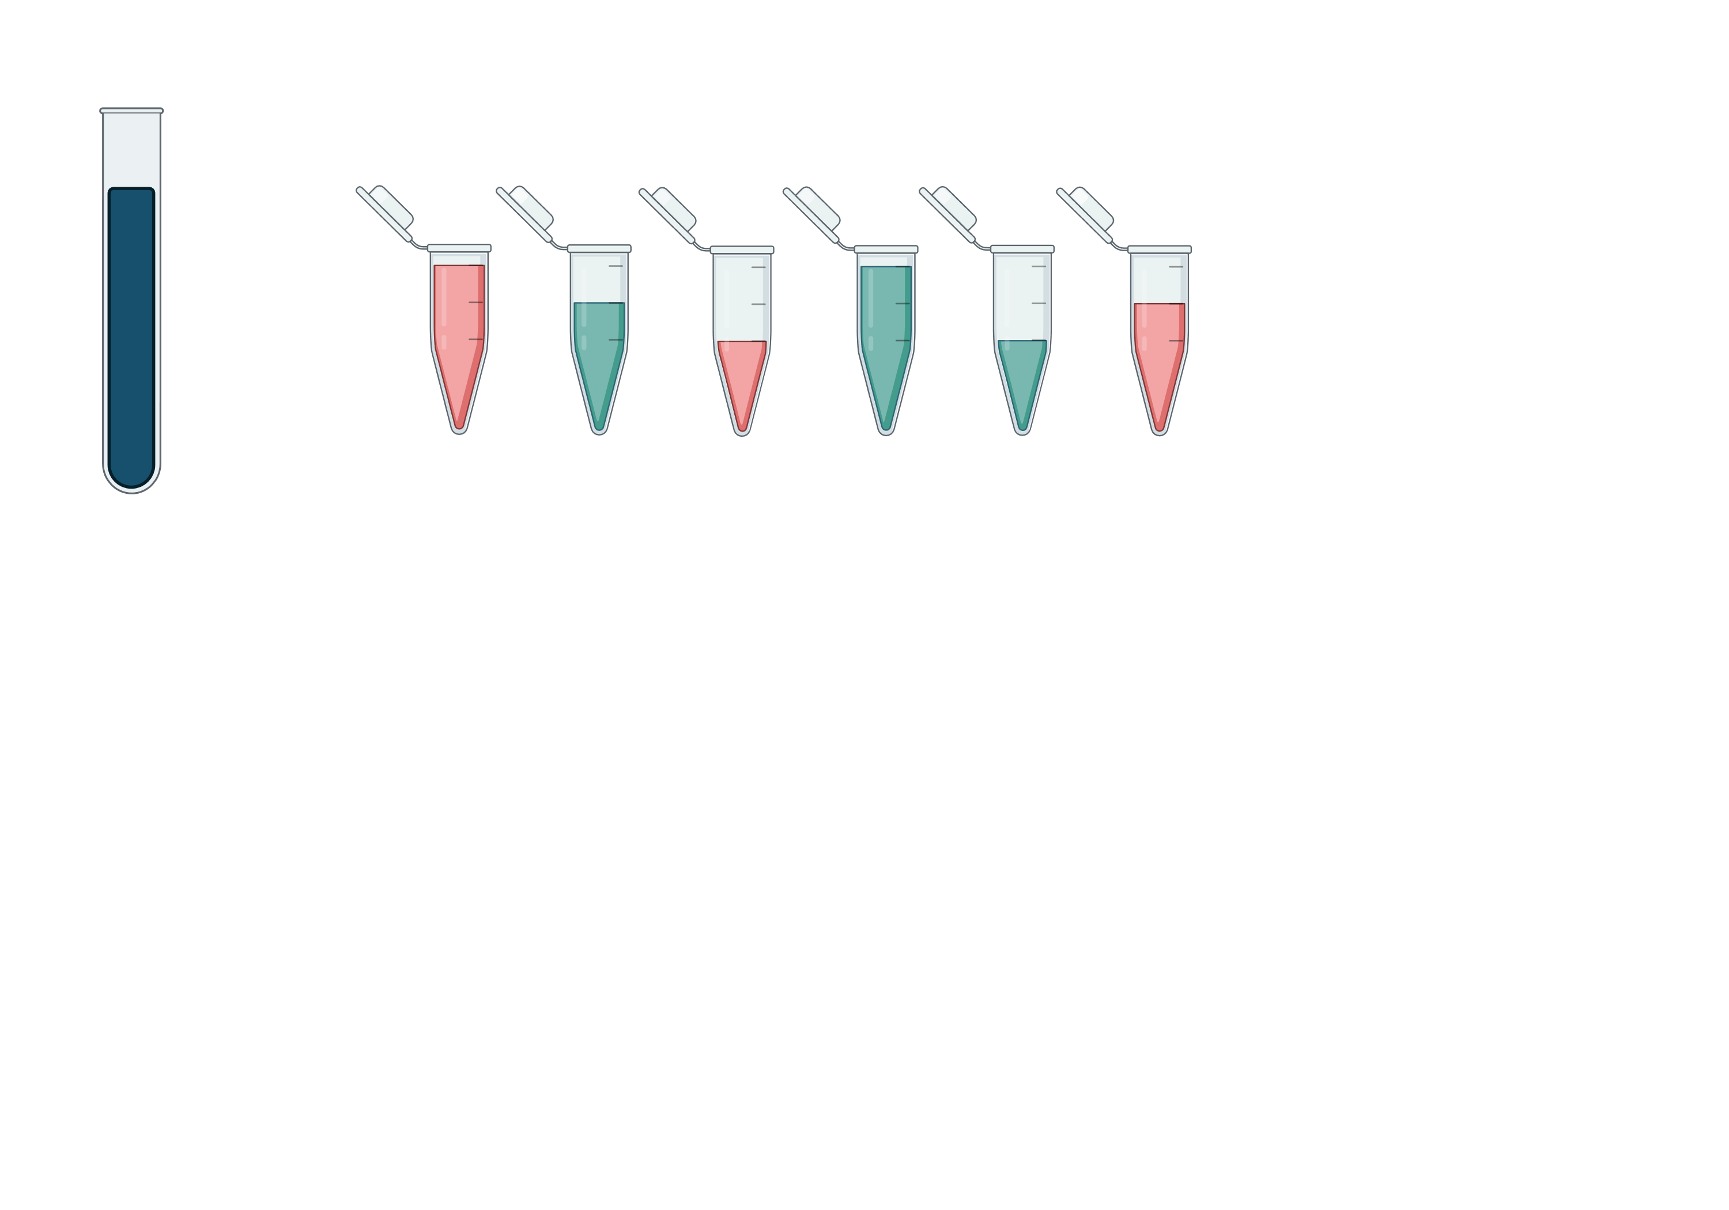
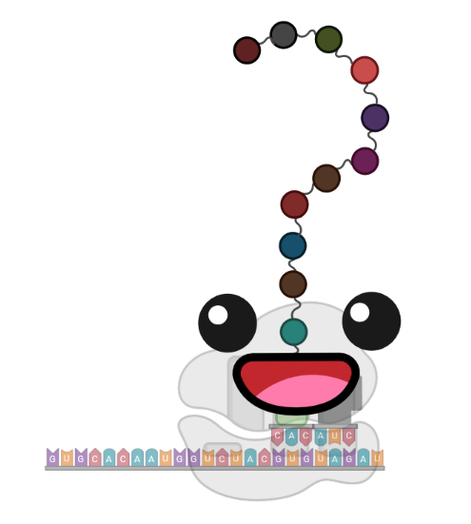
Your practical task
Uncharacterized sample
Target: Substrate
Value: Concentration
How…? Bioinstrument!
‘What can you measure with your setup?’
‘What kind of values do you get?’

Slide 5
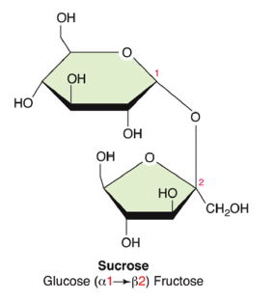
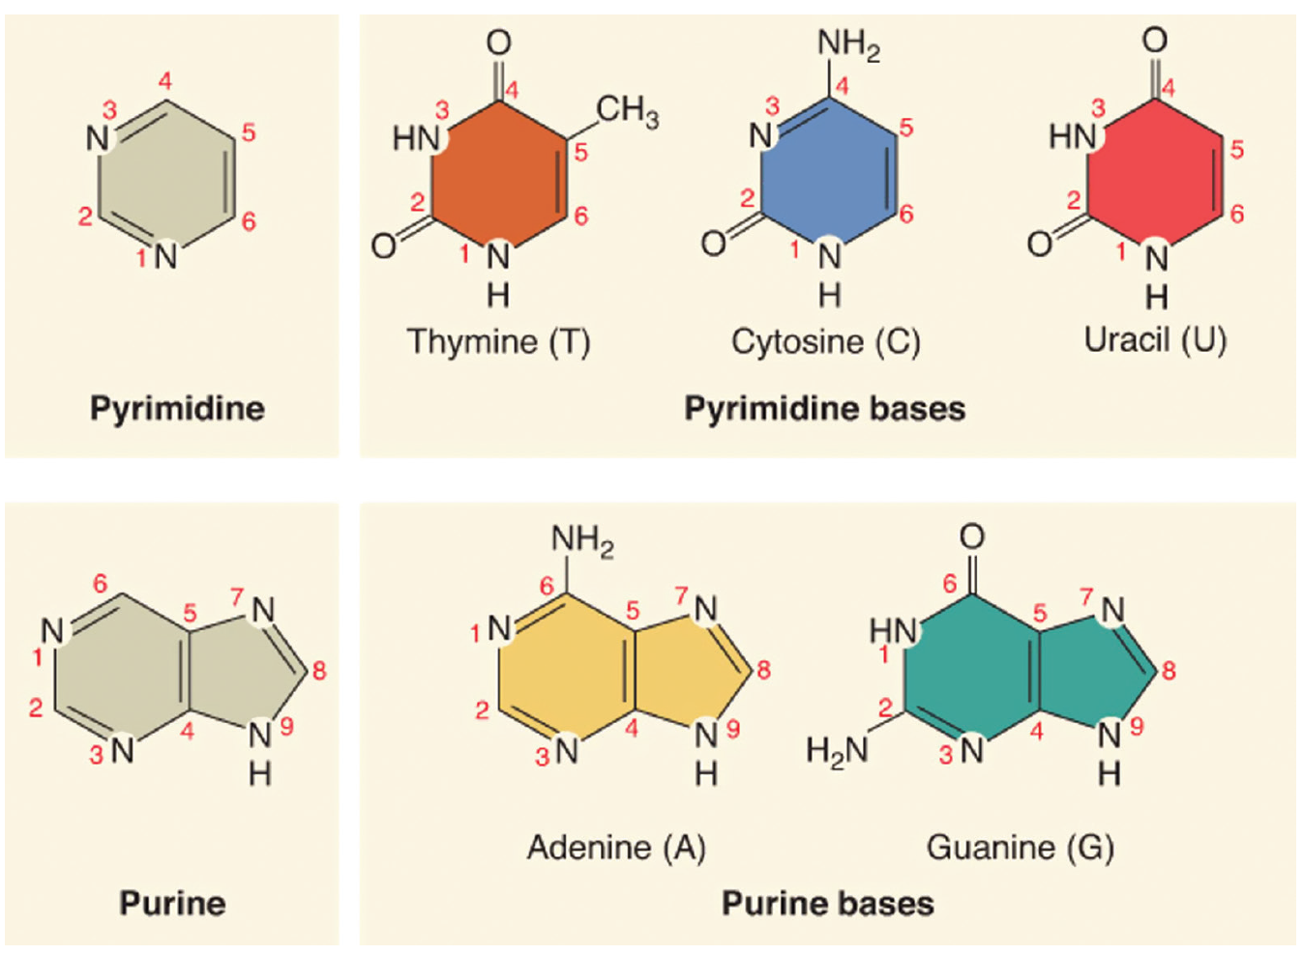
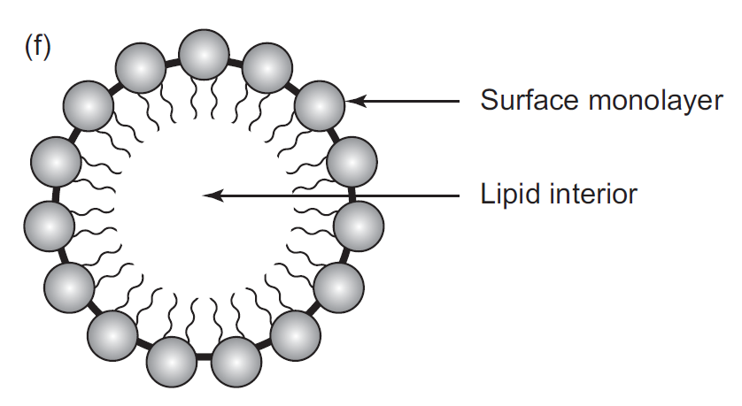
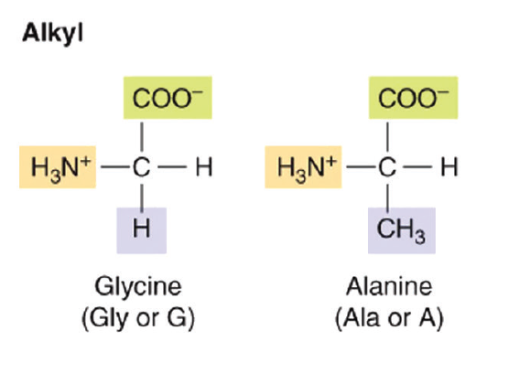
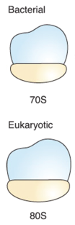
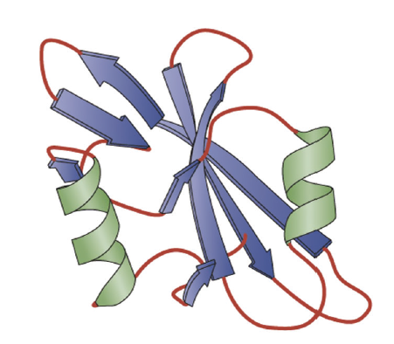
What are enzymes?
Sugars Amino acids Nucleotides Fatty acids
Enzymes
Ribozymes
Ochs, Raymond S., Biochemistry, 2022

Slide 6
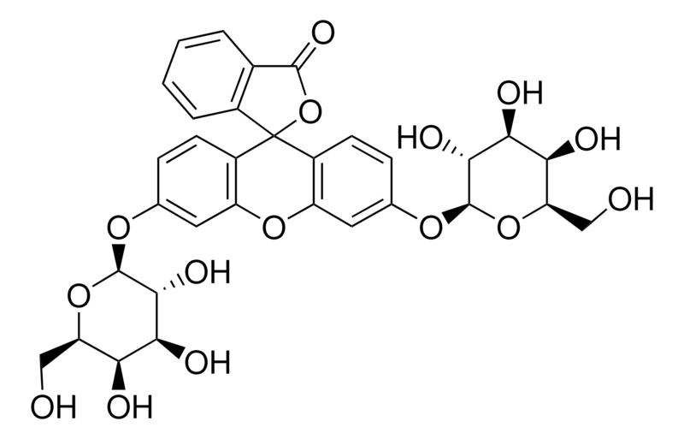
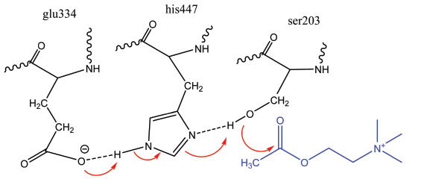
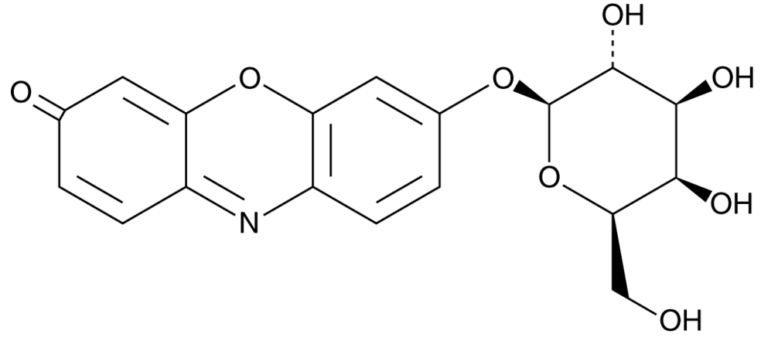
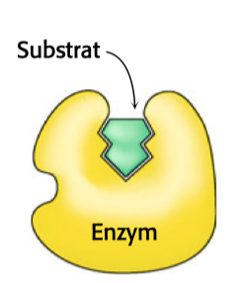
What are enzymes?
catalysis occurs in the active site
enzymes act specifically
https://www.sigmaaldrich.com/CH/de/product/sigma/f2756
Ochs, Raymond S., Biochemistry, 2022
substrate
enzyme
https://www.caymanchem.com/product/28015

Slide 7
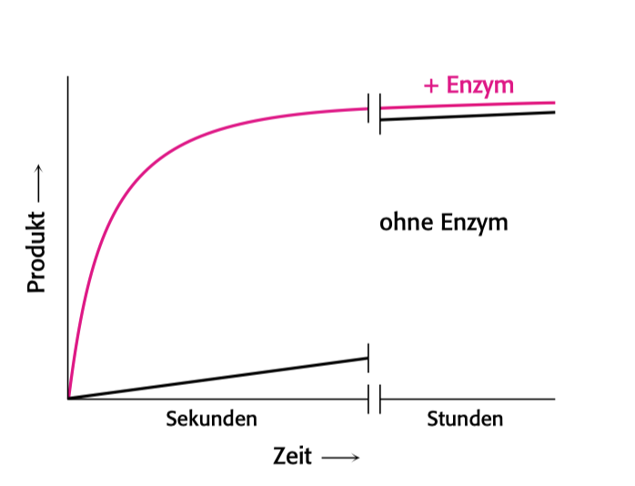
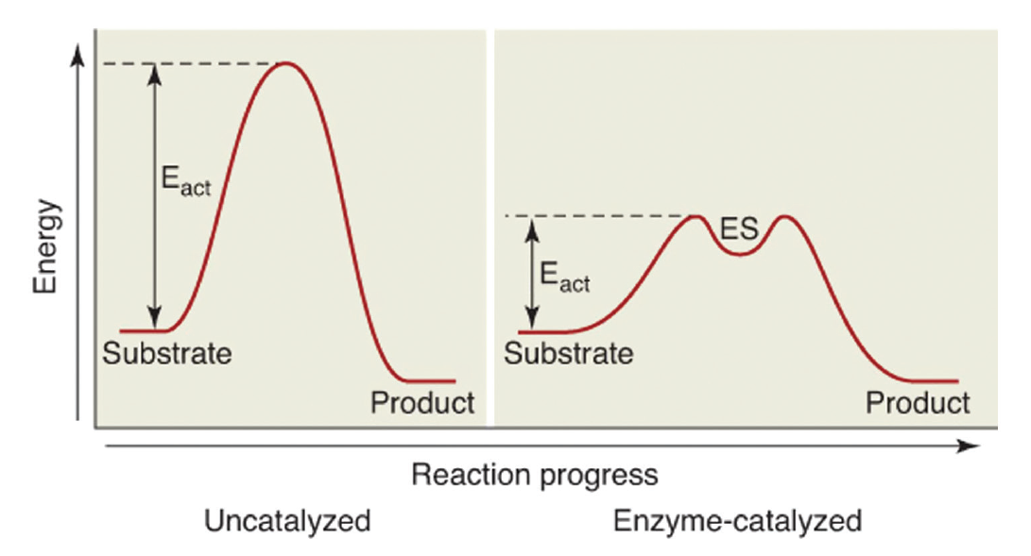
What are enzymes?
+ enzyme
= biological catalysts
= increasing the reaction rate
= not affecting the thermodynamic equilibrium
w/o enzyme
product
adapted from: Berg, Jeremy M., Tymoczko, John L., Gatto jr., Gregory J., Stryer Biochemie, 2017
seconds
hours
time
ΔG⁰ = R T ln(K_{eq})
enzymes lower the activation energy
Ochs, Raymond S., Biochemistry, 2022

Slide 8
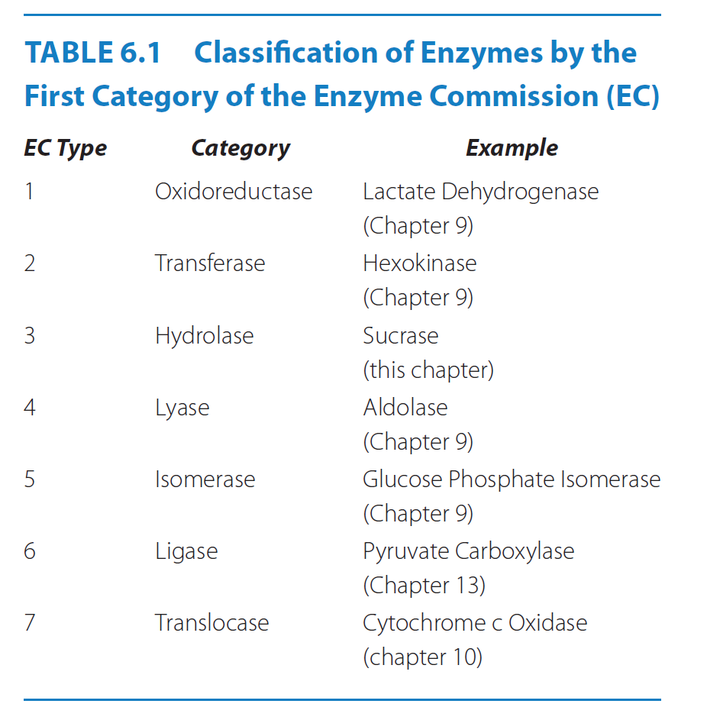
Why are enzymes of interest?
Enzymes = fundamental necessities for life
Research application
Industrial application
Medical application
… reactivity, specificity, kinetics
Bioinstrument: measures product formation or
substrate conversion
Ochs, Raymond S., Biochemistry, 2022

Slide 9
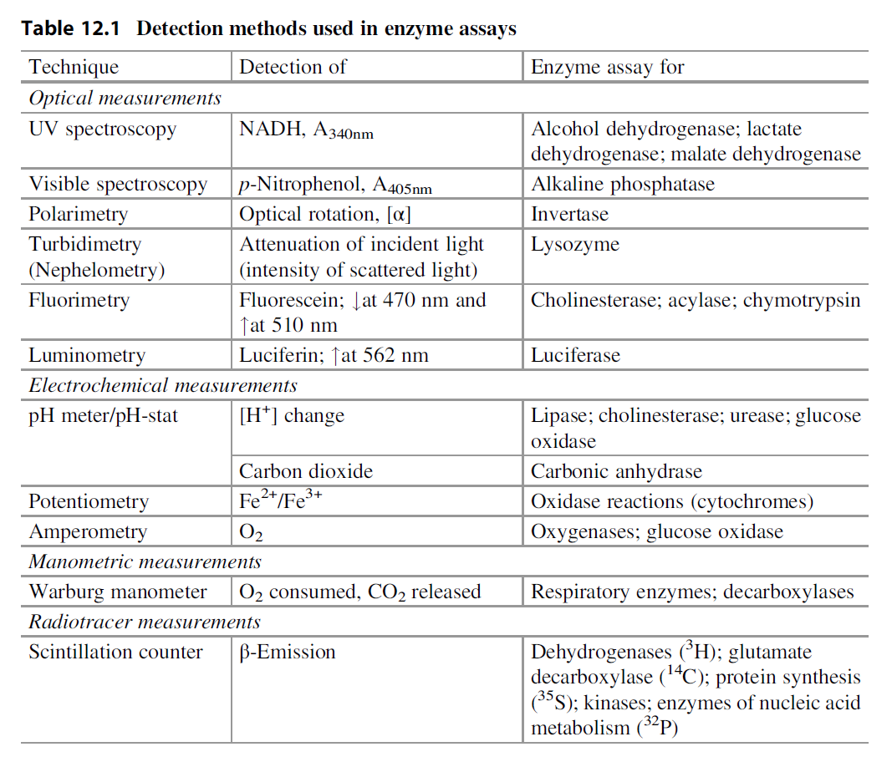
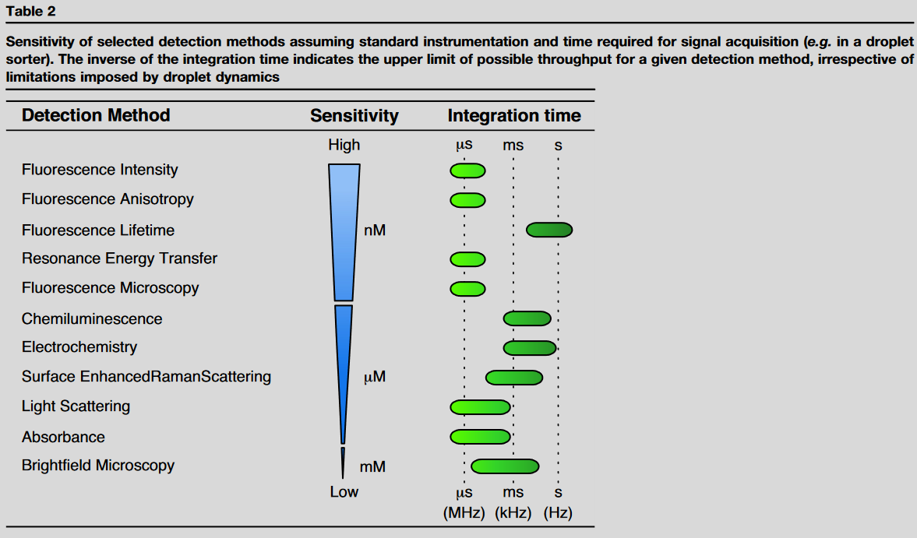
Enzyme assays
monitoring formed product
monitoring consumed substrate
> what is preferred > why?
Punekar, N.S., Enzymes: Catalysis, Kinetics and Mechanisms, 2018
Mair et al., 2017 (doi: 10.1016/j.cbpa.2017.02.018)

Slide 10
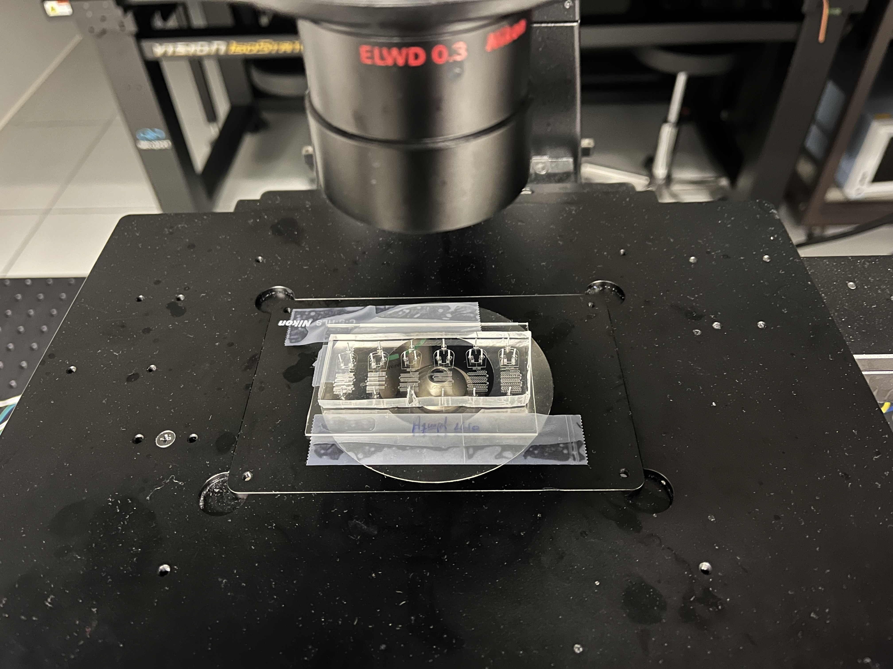
Enzyme assays
Fluorometric assays
= more sensitive vs. absorption-based methods
…however, providing a relative value
‘Which factors could vary between experiments?’

Slide 11
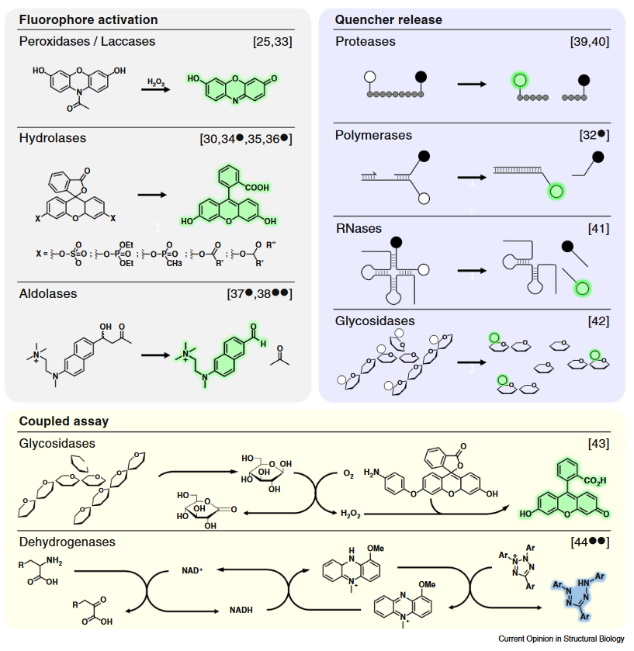
Enzyme applications
Bunzel et al., 2018
(doi: 10.1016/j.sbi.2017.12.010)

Slide 12
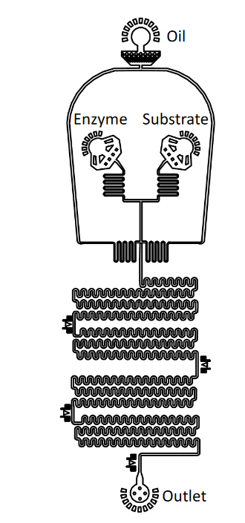
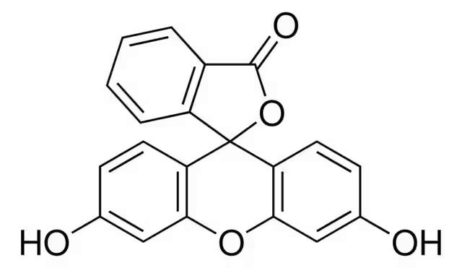
Substrate conversion
https://www.sigmaaldrich.com/CH/de/product/sigma/f2756
https://www.sigmaaldrich.com/CH/de/substance/fluorescein332312321075
fluorescein di-β-D-galactopyranoside (FDG)
fluorescein
cleavage in presence of an enzyme

Slide 13
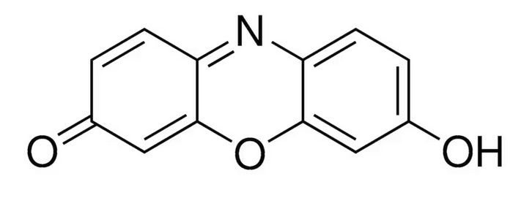
Substrate conversion
https://www.caymanchem.com/product/28015
https://www.sigmaaldrich.com/CH/de/product/sigma/73144
resorufin di-β-D-galactopyranoside (RDG)
resorufin
cleavage in presence of an enzyme

Slide 14
Back to your practical task
Enzyme: Beta-galactoside (EC 3.2.1.23)
4 groups and 2 different substrates
Substrate: fluorescein di-β-D-galactopyranoside (FDG) (498 nm / 517 nm)
resorufin di-β-D-galactopyranoside (RDG) (571 nm / 585 nm)
‘What is your substrate concentration?’
‘What is the physiological role of your enzyme?’
Final report
‘What are (potential) applications?’

Slide 15
Ochs, Raymond S., Biochemistry, 2022
How do enzymes work?
enzymes lower the activation energy
k₁
k_{cat}
E + S ES E + P
k₋₁
E = enzyme
S = substrate
P = product
(1) Steady state: rate of ES formation = rate of ES destruction
[E]_{total} = [E] + [ES]
(2) Enzyme concentration:
(3) Initial velocity (rate of reaction): v = k_{cat} [ES]
(4) Maximum velocity (maximum rate of reaction): v_{max} = k_{cat} [E]_{total}

Slide 16

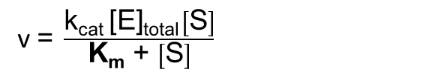

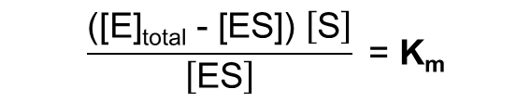
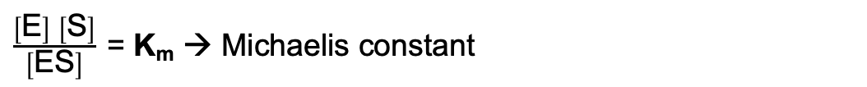
k₁
k_{cat}
Michaelis-Menten equation
E + S ES E + P
k₋₁
(1)
rate of ES formation = rate of ES destruction
k₁ [E] [S] = k₋₁ [ES] + k_{cat} [ES]
$$\frac{\left[\text{E}\right] \left[\text{S}\right]}{\left[\text{ES}\right]} \text{= }\frac{\text{k}\text{cat} \text{+ }\text{k}\text{−1}}{\text{k}\text{1}}$$
$\frac{\left[\text{E}\right] \left[\text{S}\right]}{\left[\text{ES}\right]} \text{= }\text{K}\text{m}$ → Michaelis constant
$$\frac{\text{(}\text{[}\text{E}\text{]}\text{total}\text{ −}\text{ [}\text{ES}\text{]}\text{) }\left[\text{S}\right]}{\left[\text{ES}\right]}\text{ = }\text{K}\text{m}$$
[E]_{total} = [E] + [ES]
(2)
$$\left[\text{ES}\right] \text{=} \frac{\text{[}\text{E}\text{]}\text{total} \left[\text{S}\right]}{\text{K}\text{m}\text{ + }\left[\text{S}\right]}$$
v $\text{=} \frac{\text{k}\text{cat} \text{[}\text{E}\text{]}\text{total} \left[\text{S}\right]}{\text{K}\text{m}\text{ + }\left[\text{S}\right]}$
v = k_{cat} [ES]
(3)

Slide 17
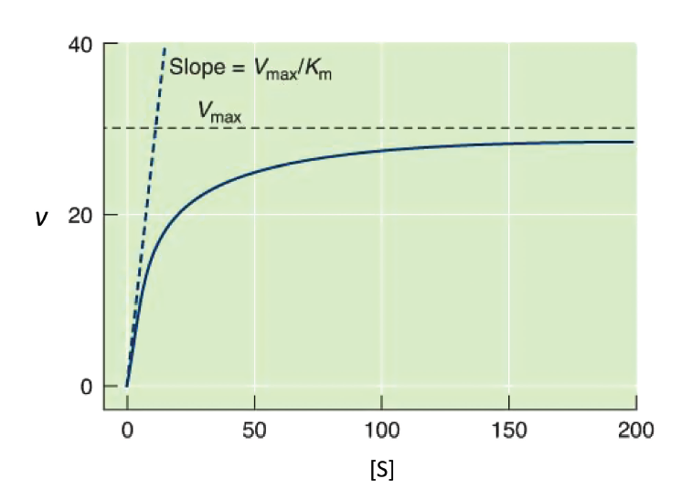
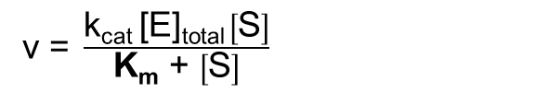
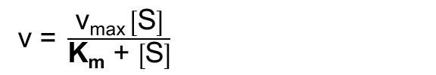
k₁
k_{cat}
Michaelis-Menten equation
E + S ES E + P
k₋₁
v $\text{=} \frac{\text{k}\text{cat} \text{[}\text{E}\text{]}\text{total} \left[\text{S}\right]}{\text{K}\text{m}\text{ + }\left[\text{S}\right]}$
Ochs, Raymond S., Biochemistry, 2022
(4)
v_{max} = k_{cat} [E]_{total}
v $\text{=} \frac{\text{v}\text{max} \left[\text{S}\right]}{\text{K}\text{m}\text{ + }\left[\text{S}\right]}$

Slide 18


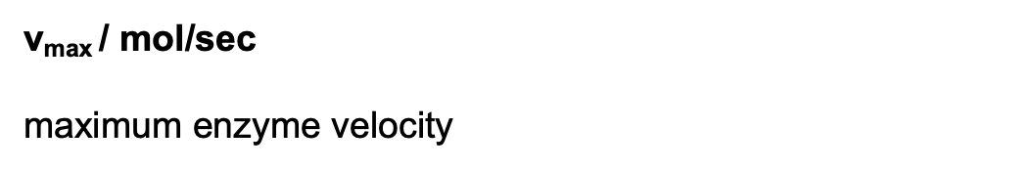
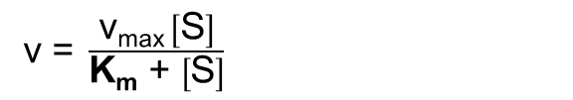
k₁
k_{cat}
Michaelis-Menten equation
E + S ES E + P
k₋₁
v $\text{=} \frac{\text{v}\text{max} \left[\text{S}\right]}{\text{K}\text{m}\text{ + }\left[\text{S}\right]}$
Ochs, Raymond S., Biochemistry, 2022
case 1: [S] >> $\text{K}\text{m}$
v $\text{=} \text{v}\text{max}$ → enzyme is saturated
case 2: [S] << $\text{K}\text{m}$
v $\text{=}\frac{\text{v}\text{max} \left[\text{S}\right]}{\text{K}\text{m}}$ → rate increases linearly with [S]
case 3: [S] = $\text{K}\text{m}$
v $\text{=}\frac{\text{1}}{\text{2}}\text{v}\text{max}$ → enzyme is working 50% of capacity
$\text{v}\text{m}\text{ax}$ / mol/sec
maximum enzyme velocity

Slide 19
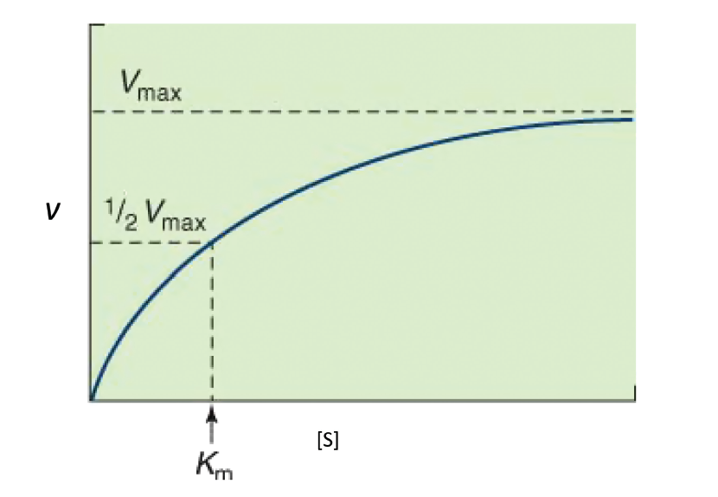

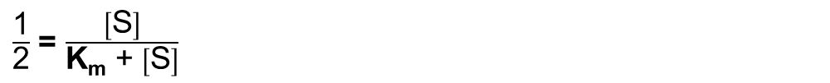
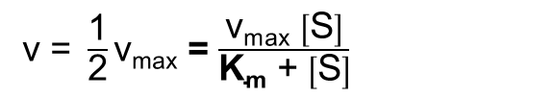
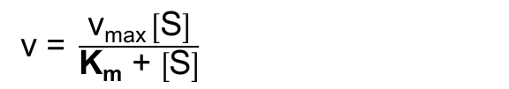
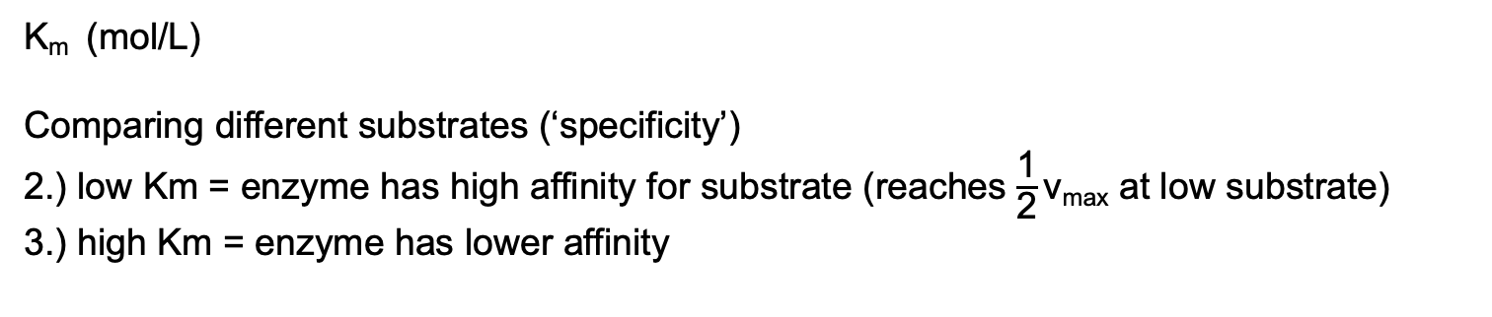
k₁
k_{cat}
Michaelis-Menten equation: K_{m}
E + S ES E + P
k₋₁
v $\text{=} \frac{\text{v}\text{max} \left[\text{S}\right]}{\text{K}\text{m}\text{ + }\left[\text{S}\right]}$
$\text{K}\text{m}$ / mol/L
Ochs, Raymond S., Biochemistry, 2022
v $\text{=} \frac{\text{1}}{\text{2}}\text{v}\text{m}\text{ax}$ = $\frac{\text{v}\text{max} \left[\text{S}\right]}{\text{K}\text{m}\text{ + }\left[\text{S}\right]}$
$\frac{\text{1}}{\text{2}}$ = $\frac{\left[\text{S}\right]}{\text{K}\text{m}\text{ + }\left[\text{S}\right]}$
$\text{K}\text{m}$= $\left[\text{S}\right]$
$\text{K}\text{m}$ (mol/L)
Comparing different substrates (‘specificity’)
2.) low Km = enzyme has high affinity for substrate (reaches $\frac{\text{1}}{\text{2}}\text{v}\text{max}$ at low substrate)
3.) high Km = enzyme has lower affinity

Slide 20
Enzyme kinetics and practical task
exemplary calculation:
‘How should the curve look like?’
substrate in excess, enzyme is limiting
‘Does the K_{m} change?’
v / mol/min
[E] is high
[E] is low
K_{m} / mol
[S] / mol

Slide 21
Enzyme kinetics and practical task
exemplary calculation:
substrate in excess, enzyme is limiting
substrate is limiting, enzyme in excess
v / mol/min
v / mol/min
[E] is high
[E] is high
[E] is low
[E] is low
→ K_{m} / mol
K_{m} / mol
[S] / mol
[S] / mol

Slide 22
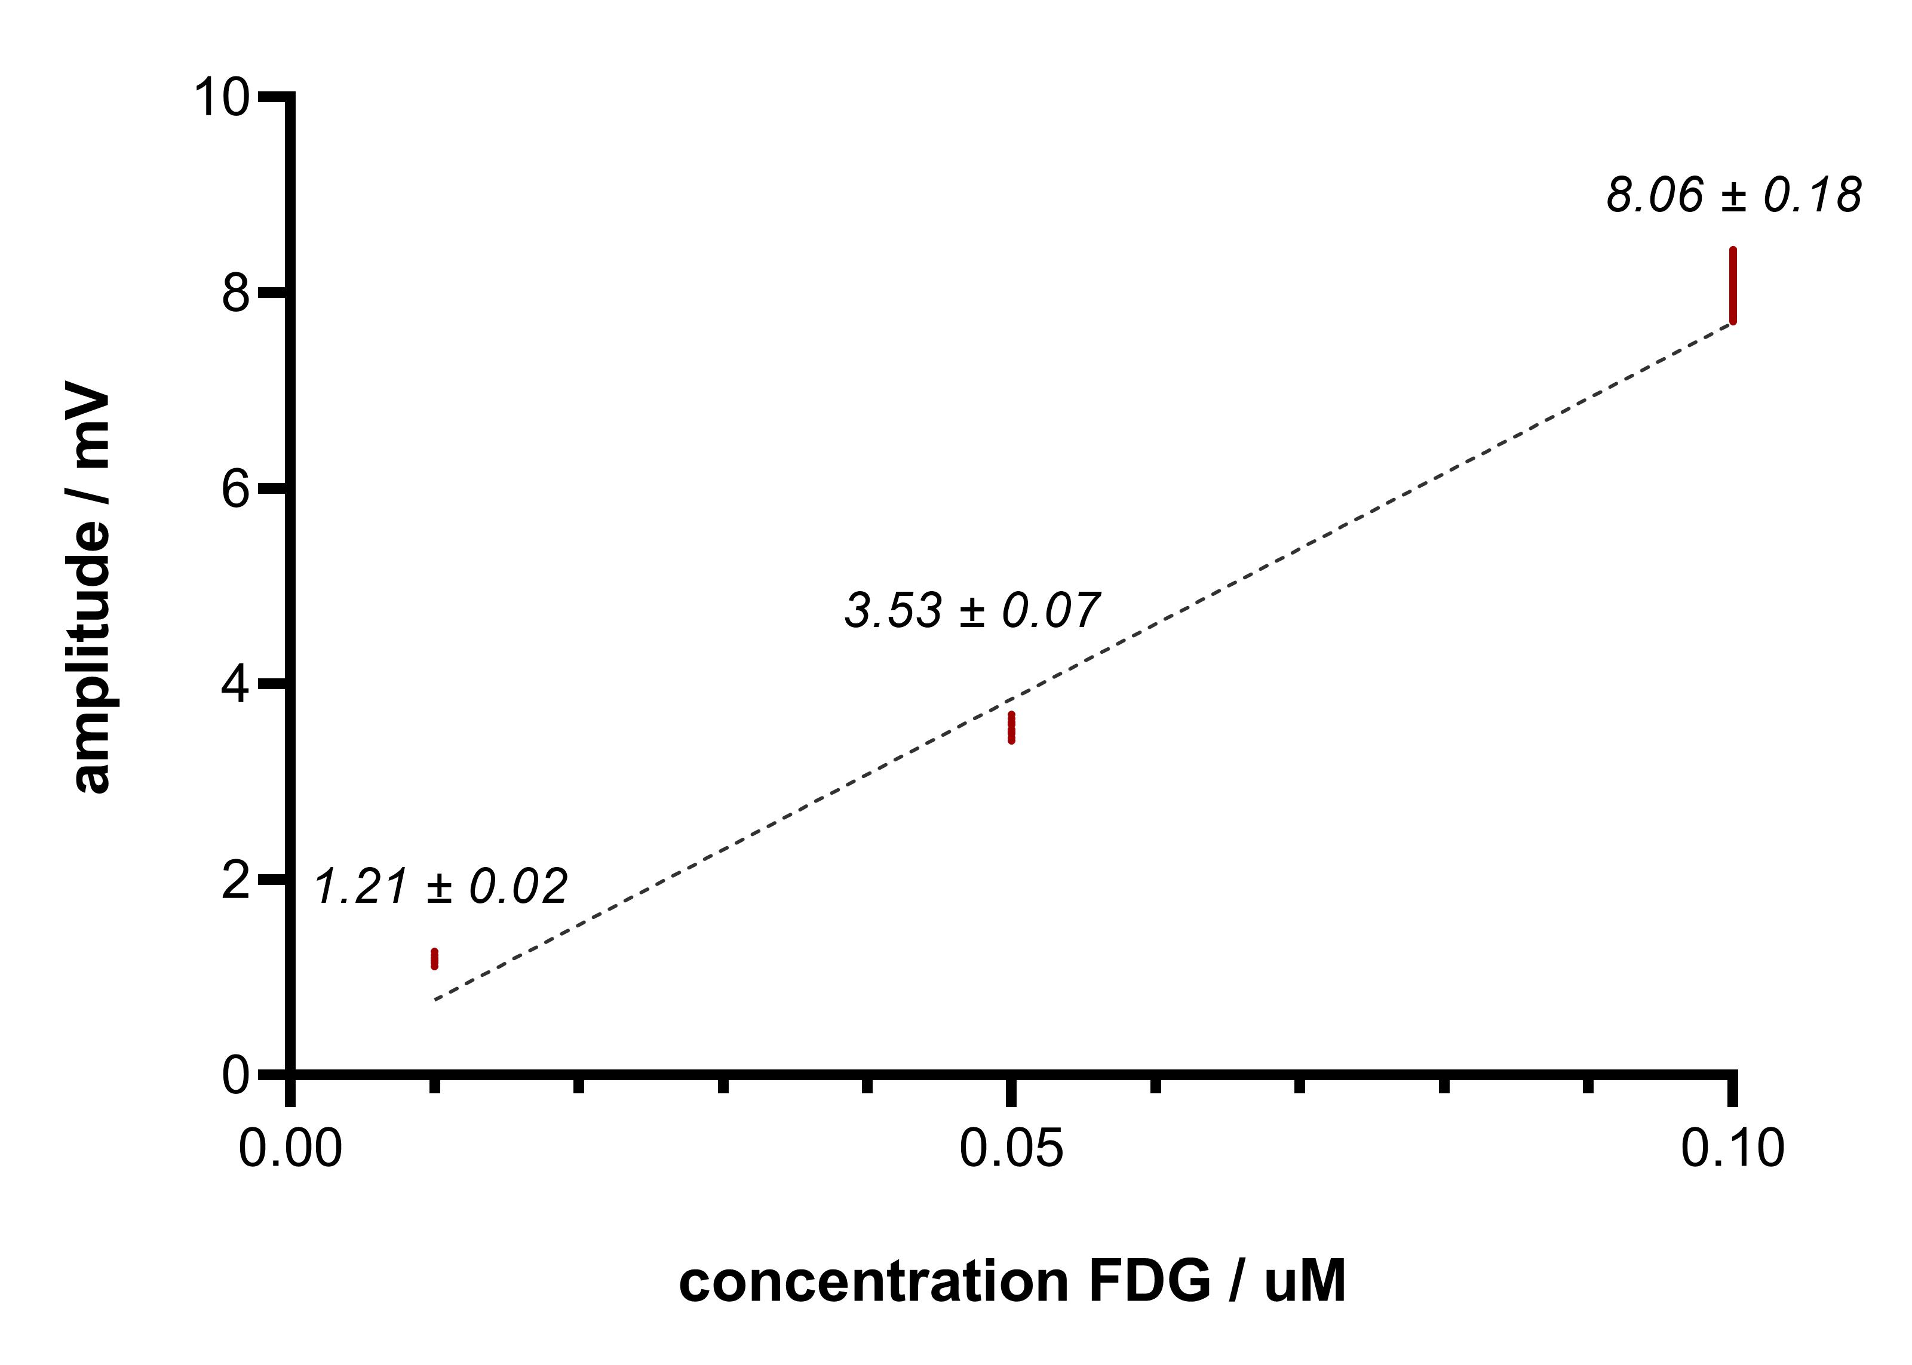
Some help…
Calibration curve → converts a bioinstrument signal into a known quantity
y = 76.95 x
substrate concentration / uM

Slide 23
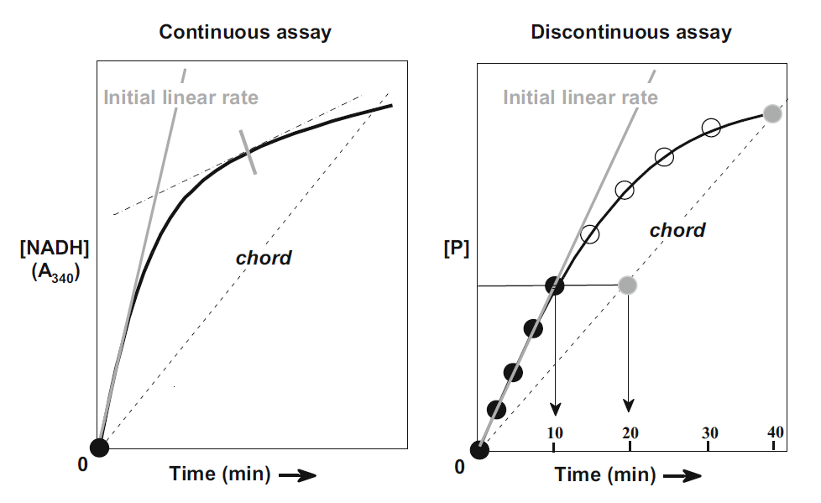
Enzyme assays
‘Difficulties with indirect assays?’
> direct assay vs. indirect assay (usually, coupled-enzyme assays)
> continuous assay vs. discontinuous/end-point assay
Punekar, N.S., Enzymes: Catalysis, Kinetics and Mechanisms, 2018

Slide 24
Enzyme assays
> loss of linearity… why?
continuous substrate consumption
more product: increased backward reaction
formed product may inhibit the enzyme
product formation could change the pH
instability of enzyme or substrate
Punekar, N.S., Enzymes: Catalysis, Kinetics and Mechanisms, 2018

Slide 25
Enzyme assays
Good practices
> apply concentrated stock solutions (why?)
> controls: enzyme minus & substrate minus
> consider: pH, ionic strength and temperature

Slide 26
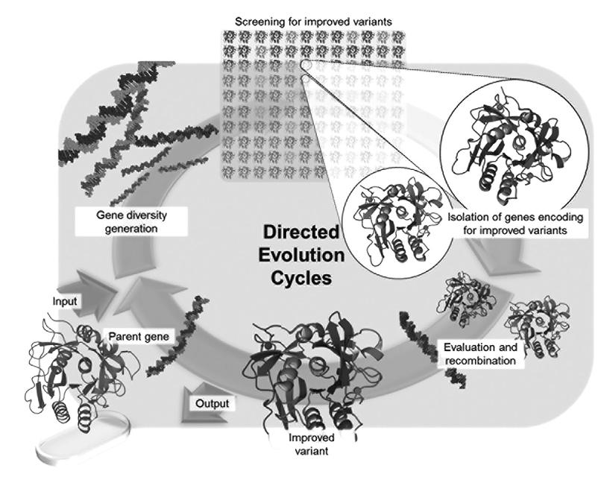
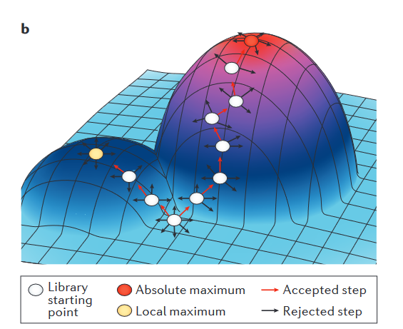
Enzyme applications
Directed evolution
new enzyme variants
desired activity
e.g., digesting unnatural substrates
Packer & Liu
(doi: 10.1038/nrg3927)
Chiu & Stavrakis
(doi: 10.1002/elps.201900222)

Slide 27
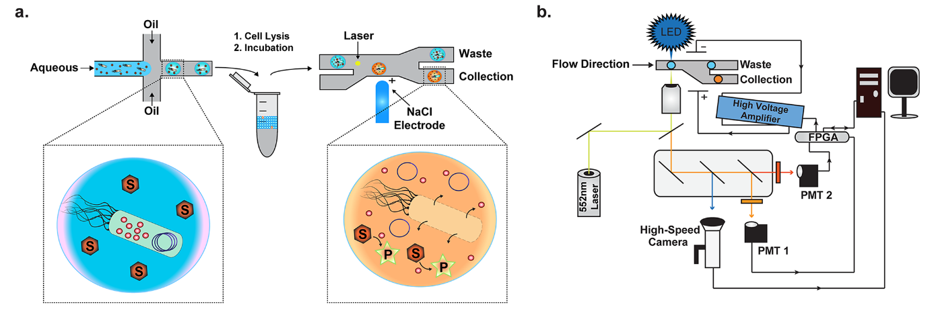
Enzyme applications
Directed evolution
new enzyme variants
desired activity
e.g., digesting unnatural substrates
Vallejo et al., 2019
(doi: 10.1021/acssynbio.9b00103)

Slide 28
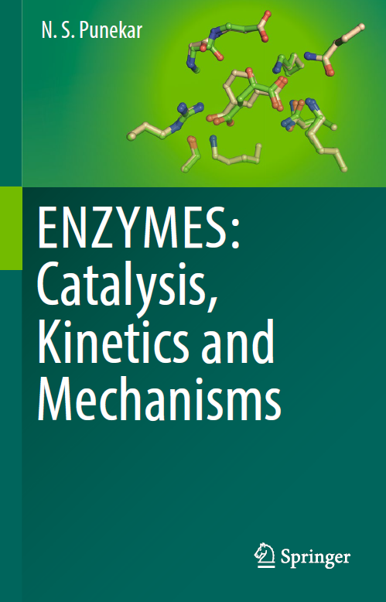
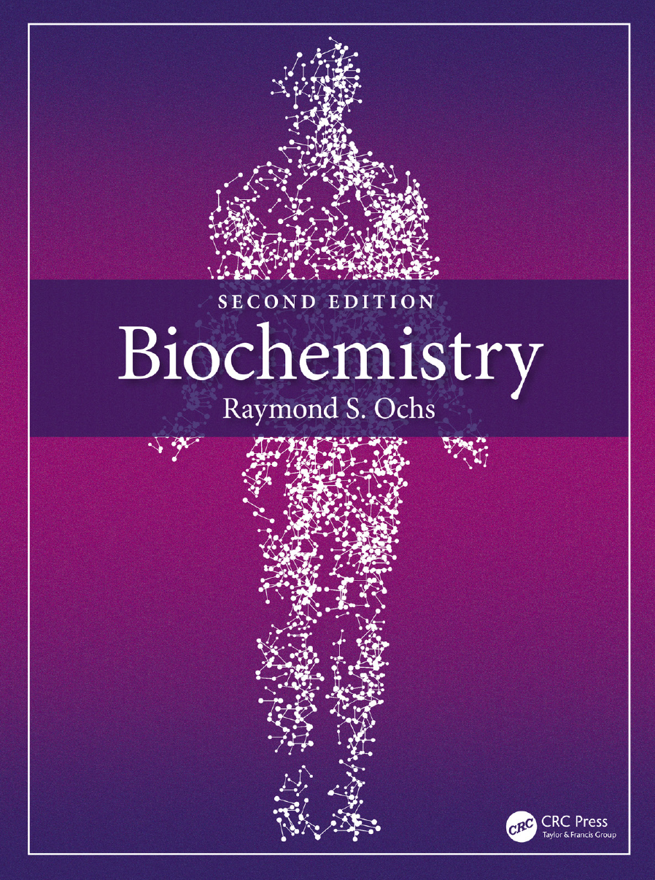
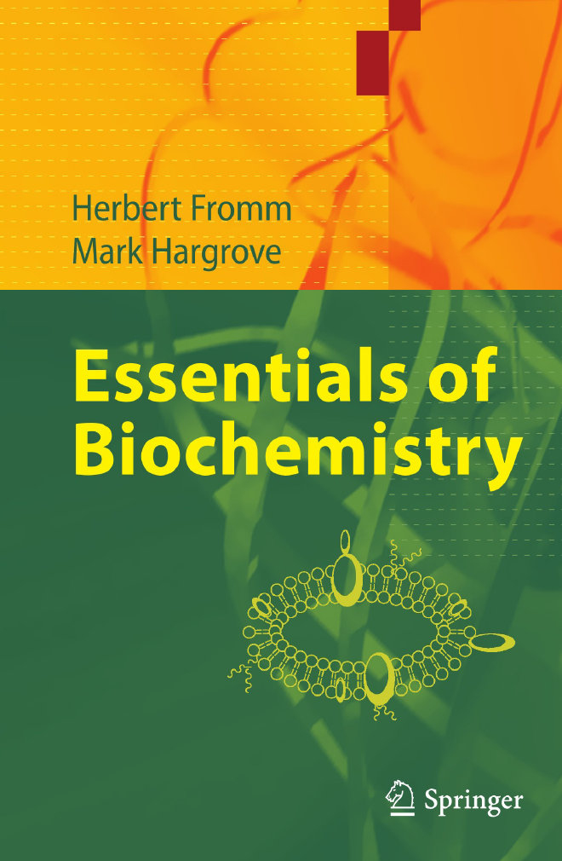
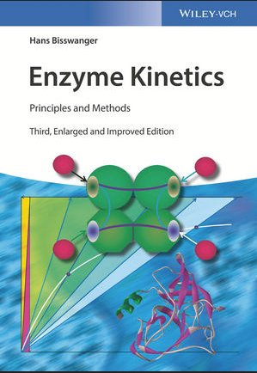

Graphical illustrations were made with BioRender.com
References and further literature
https://doi.org/10.1007/978-981-13-0785-0
https://doi.org/10.1201/9781003029649
https://doi.org/10.1007/978-3-642-19624-9
https://doi.org/10.1002/9783527806461
https://doi.org/10.1007/978-3-662-54620-8
Punekar, N.S., Enzymes: Catalysis, Kinetics and Mechanisms, Singapore, Springer Nature, 2018
Ochs, Raymond S., Biochemistry, 2nd edition, Boca Raton, CRC Press, 2022
Fromm, Herbert & Hargrove, Mark, Essentials of Biochemistry, Berlin, Heidelberg, Springer, 2012
Bisswanger, Hans, Enzyme Kinetics: Principles and Methods, 3rd edition, Weinheim, Wiley-VCH, 2017
Berg, Jeremy M., Tymoczko, John L., Gatto jr., Gregory J., Stryer Biochemie, 8th edition, Berlin, Heidelberg, Springer Spektrum, 2017
Mair et al., 2017 (doi: 10.1016/j.cbpa.2017.02.018)
Publications:
Obexer et al., 2016 (doi: 10.1093/protein/gzw032)
Chiu & Stavrakis (doi: 10.1002/elps.201900222)
Bunzel et al., 2018 (doi: 10.1016/j.sbi.2017.12.010)
Packer & Liu, 2015 (doi: 10.1038/nrg3927)
Vallejo et al., 2019 (doi: 10.1021/acssynbio.9b00103)

